Slide 1
Paediatric first aid training course

Slide 2


Slide 3
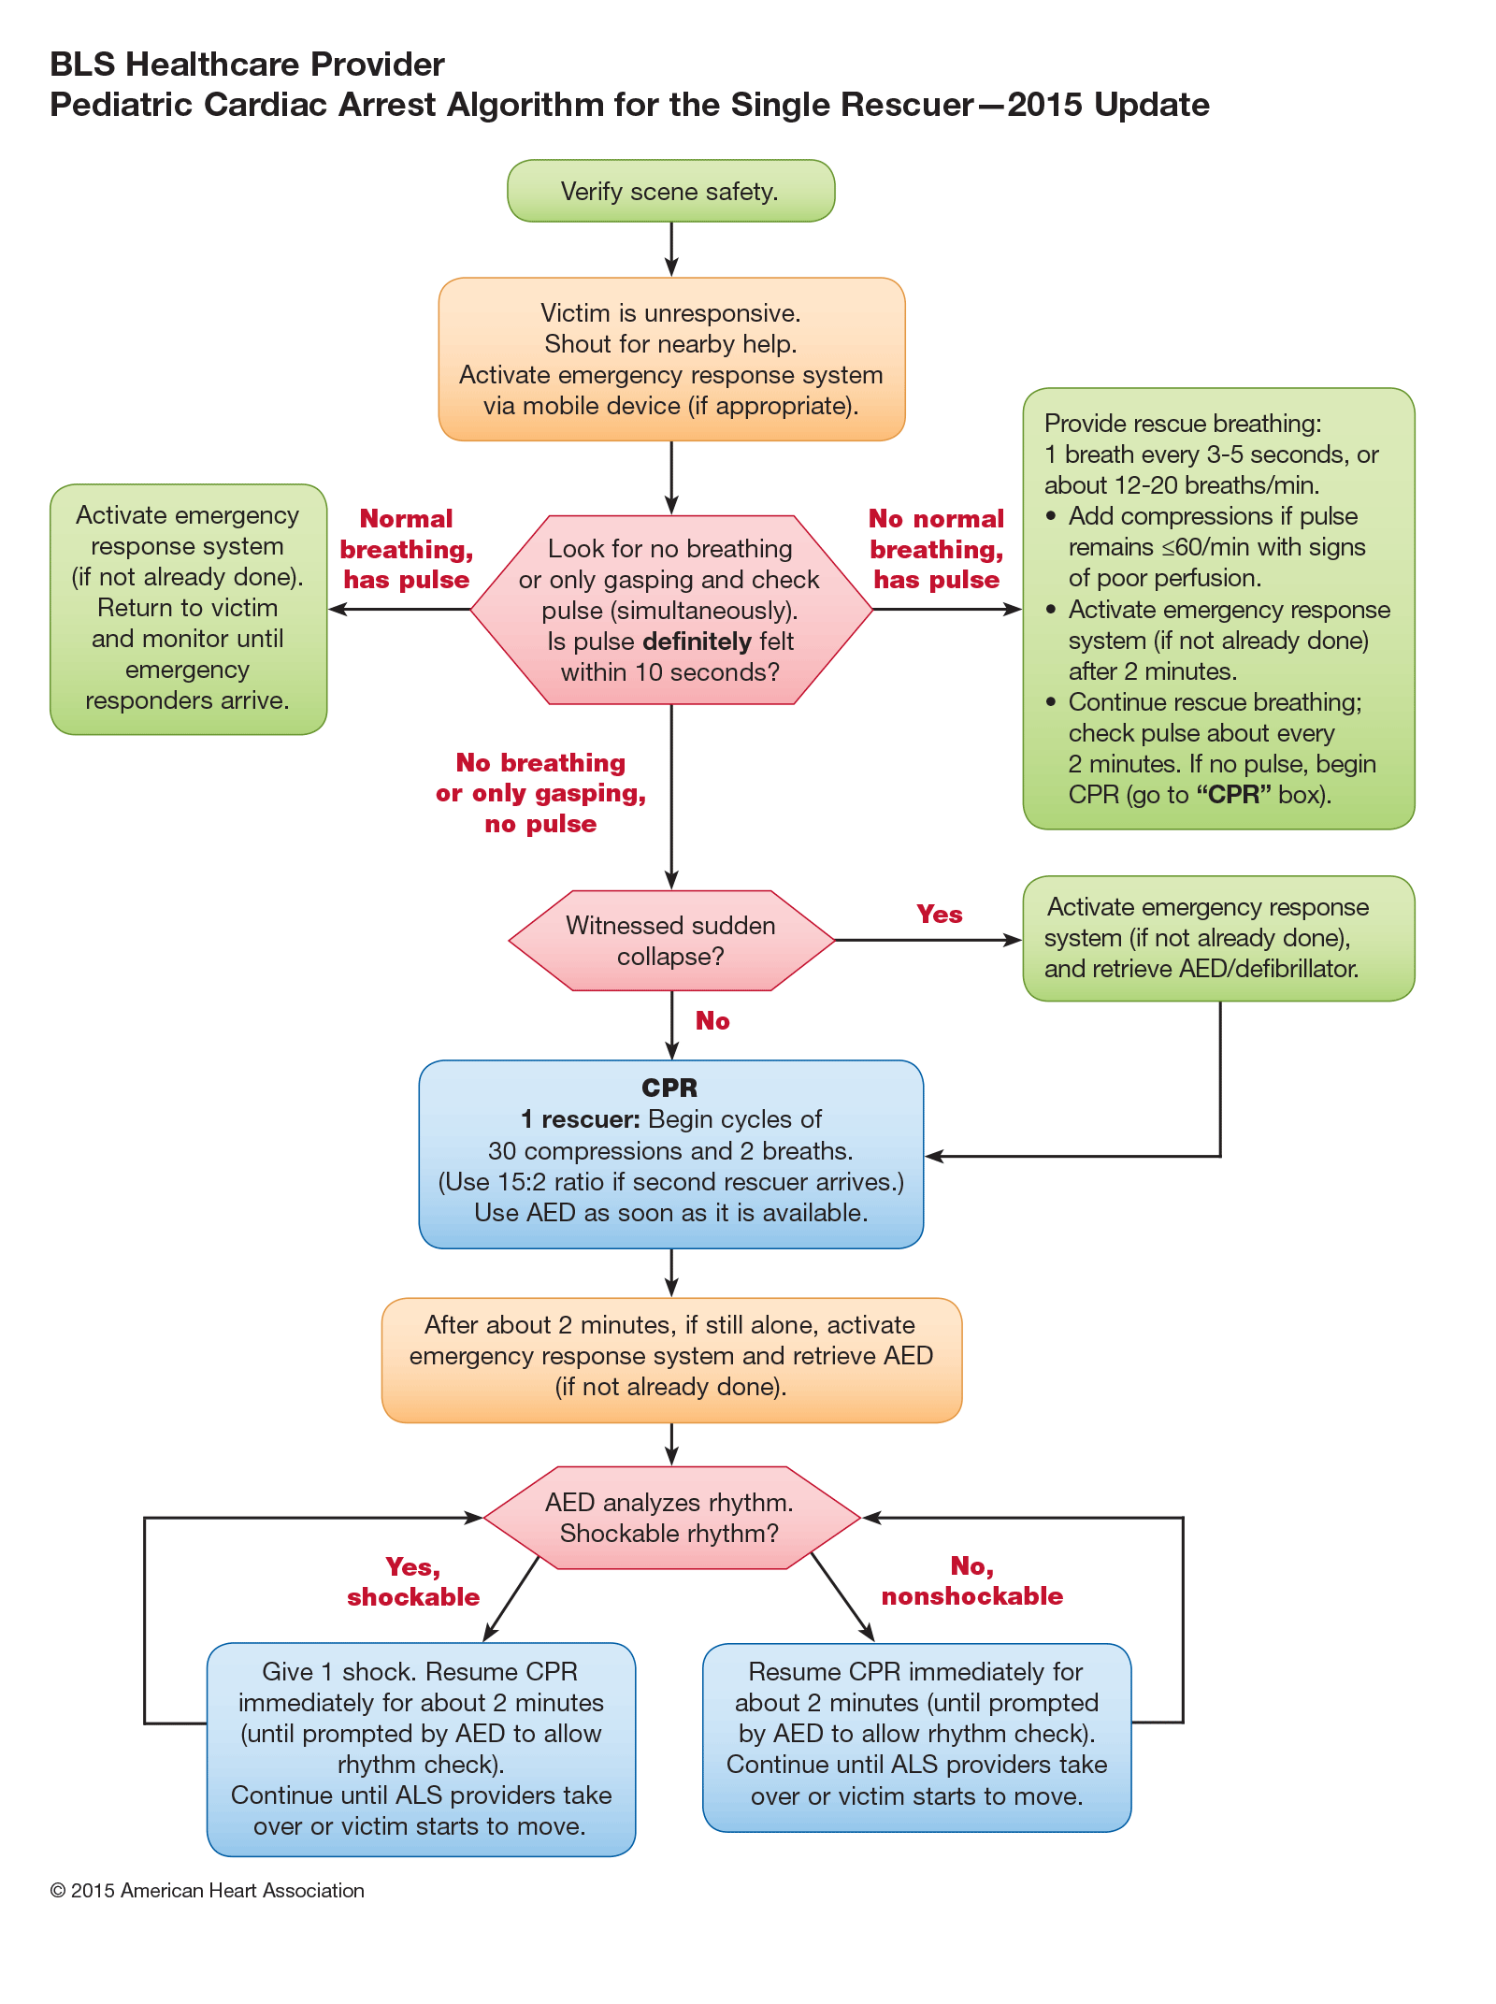

Slide 5
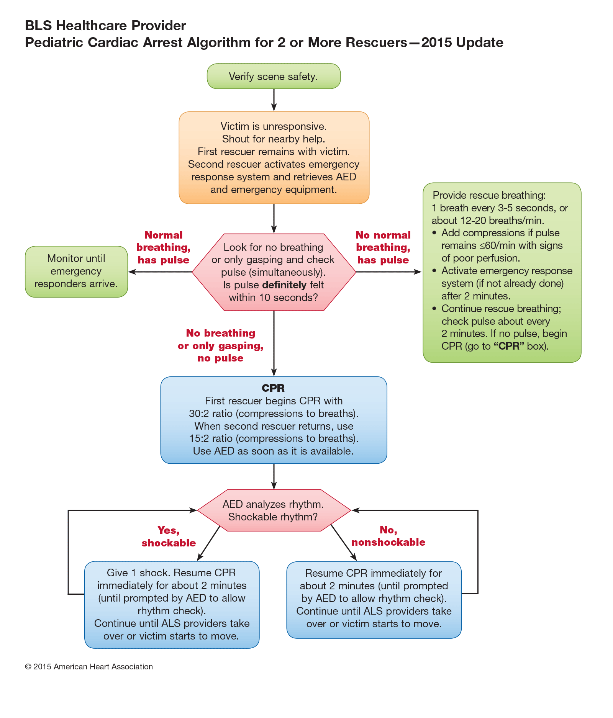

Slide 6
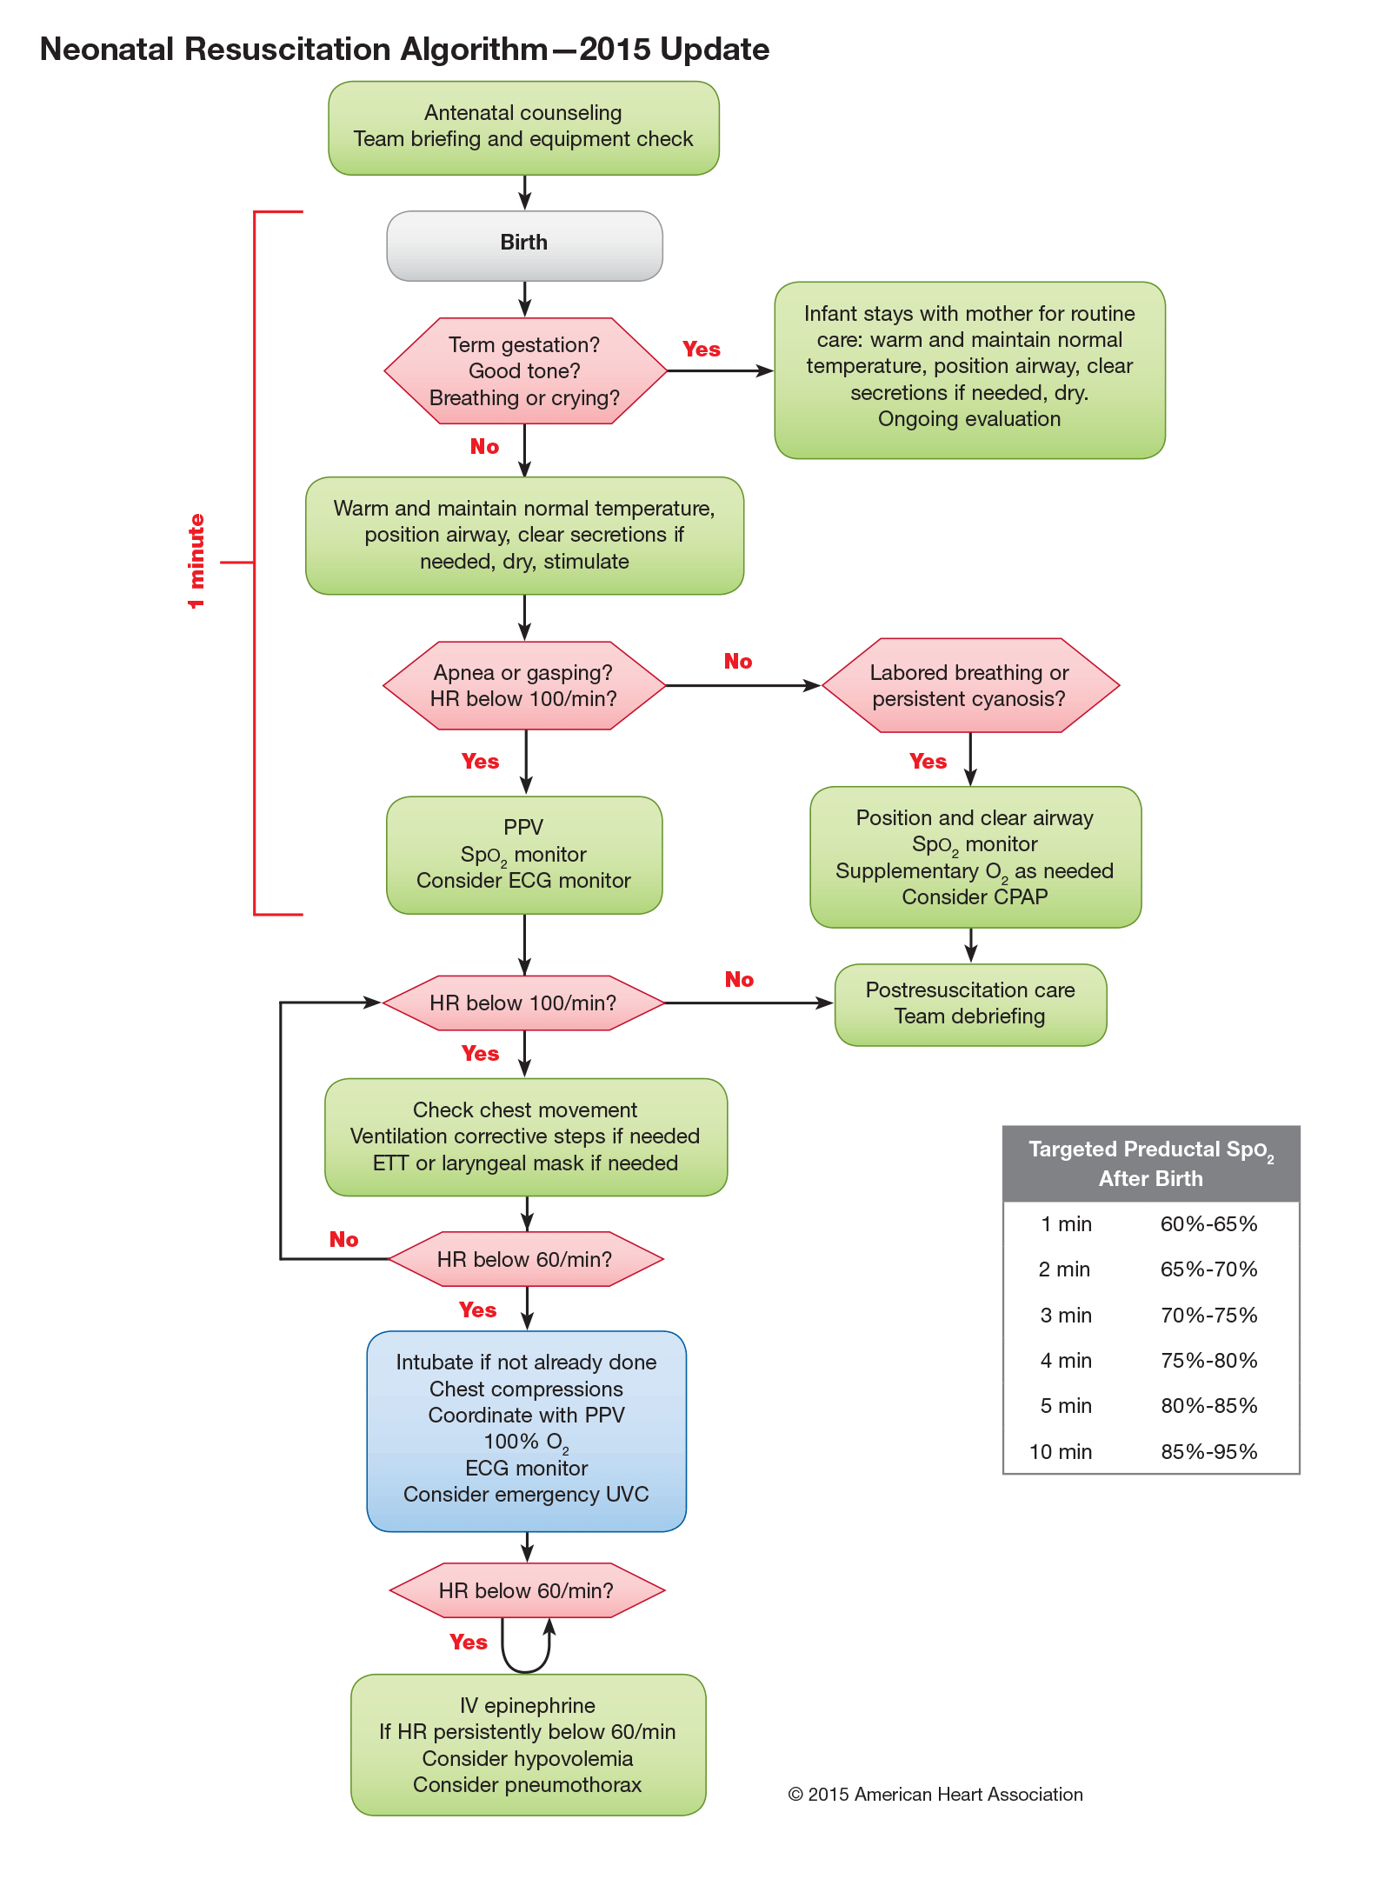

Slide 7
Cardiopulmonary resuscitation
In children most cardiac arrest is due to hypoxia and acidosis causing cell damage and death in more sensitive organs such as the brain ,liver and kidney before myocardial damage is severe enough to cause cardiac arrest.

Slide 8
Cardiopulmonary resuscitation
Most other cardiac arrests are due to circulatory failure
In adults cardiac arrest is mostly due to primary cardiac disease.

Slide 10
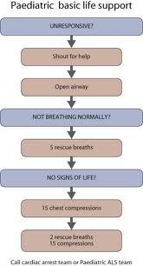

Slide 11
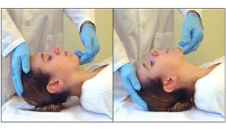
Patent airway
Jaw and neck positioning maneuvers
Head tilt chin left technique
Sniffing position Used in children

Slide 12
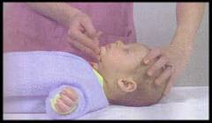
Patent airway
Jaw and neck positioning maneuvers
Head tilt chin left technique
Neutral position used in infant

Slide 13
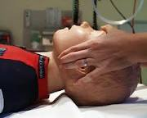
Patent airway
Jaw and neck positioning maneuvers
Jaw thrust
In suspected cervical spine injury

Slide 14
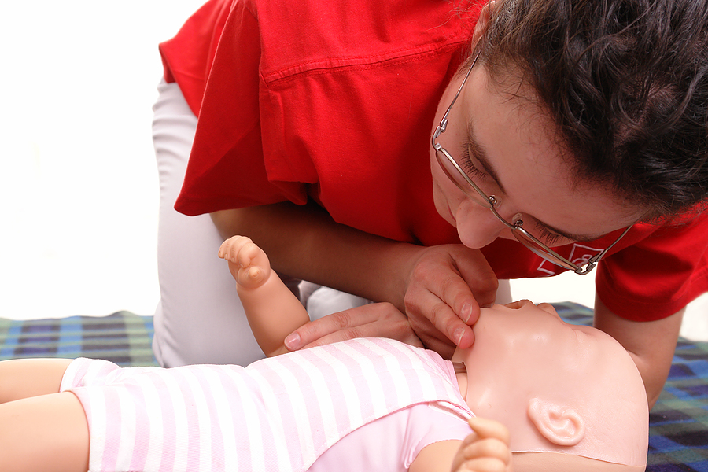
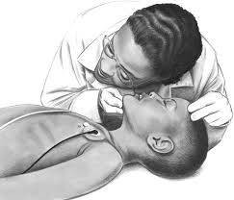
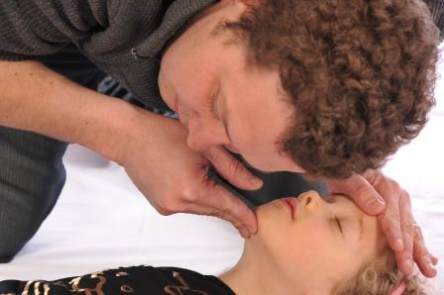
Breathing
look , listen and feel

Slide 15
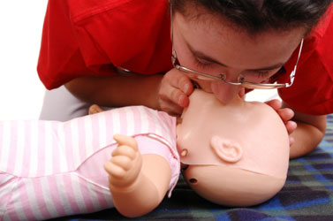
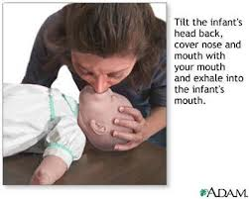
breathing

Slide 16
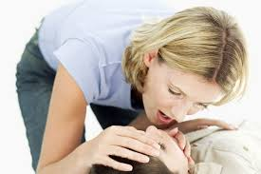
Breathing
Child :pinch nose mouth to mouth

Slide 17
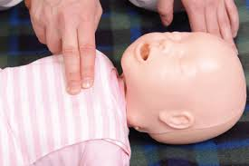
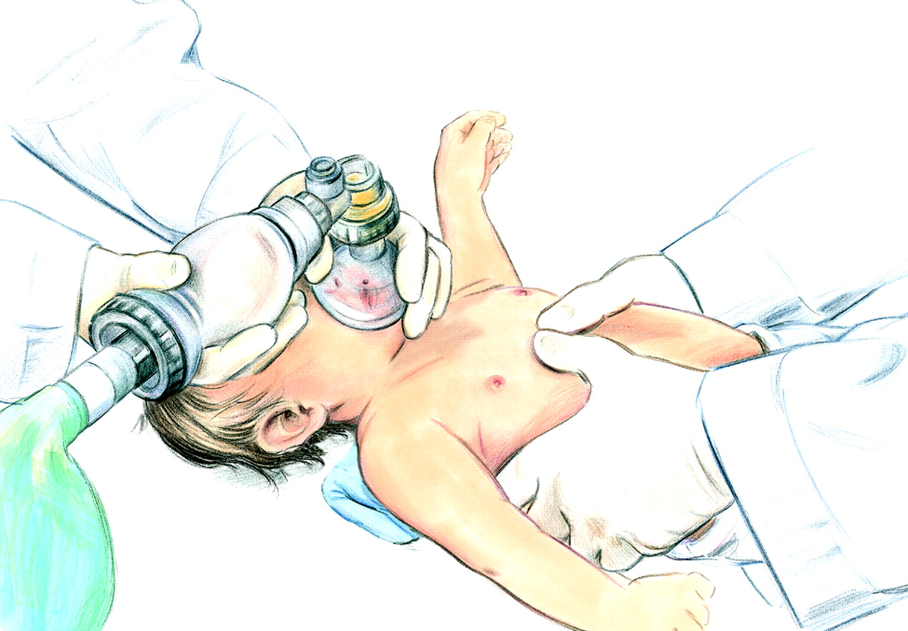
Circulation
In infants: two thumbs on lower third of the sternum with hands around the thorax (needs two rescuers)

Slide 18
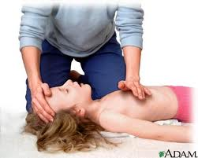
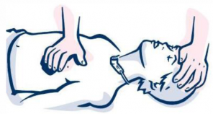
Circulation
Small child: heel of one hand over lower third of sternum

Slide 19
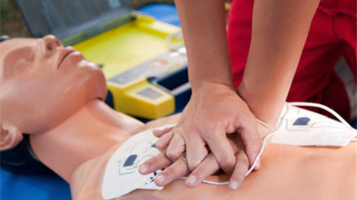
Circulation
Older children: both hands over the lower third of the sternum

Slide 21
Capillary refill time
Press on the skin of the sternum or digit at the level of the heart
Apply blanching pressure for 5 seconds
Measure time for blanch to return
Prolonged capillary refill if more than 2 seconds

Slide 22
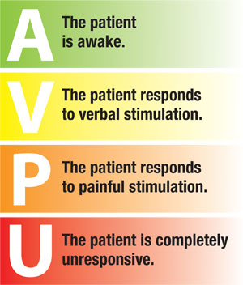
AVPU SCALE

Slide 23
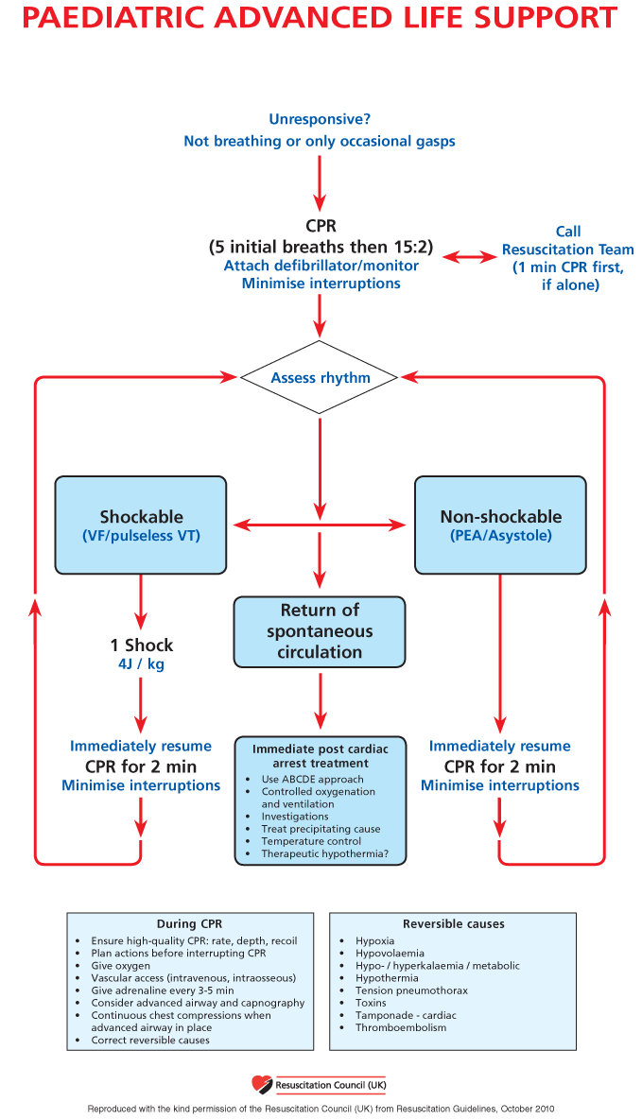

Slide 24
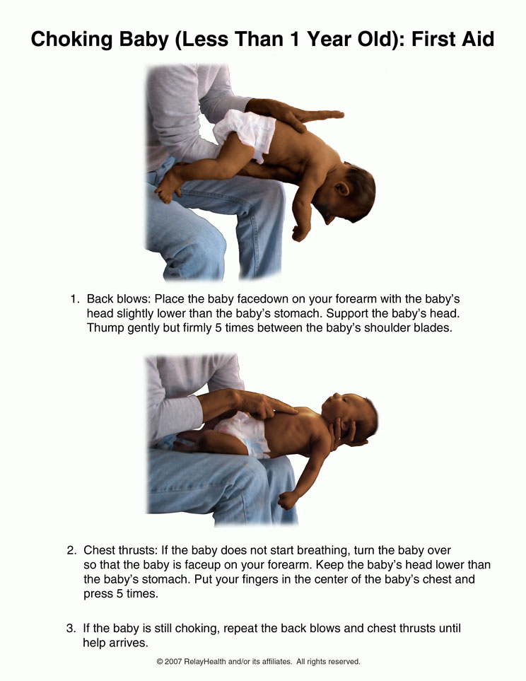

Slide 25
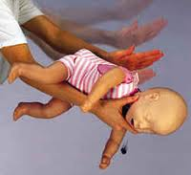
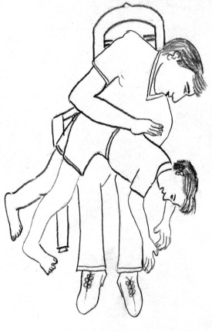
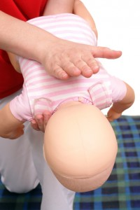
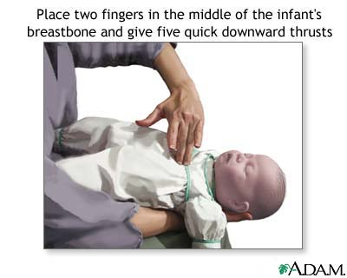
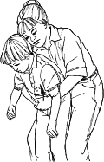
F.B inhalation

Slide 26
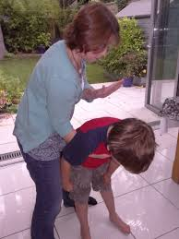
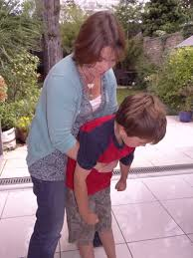
Chocking child

Slide 27
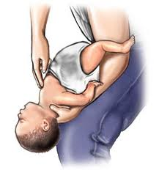
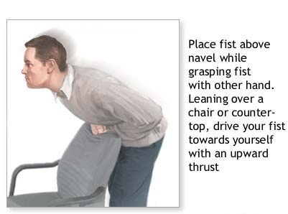
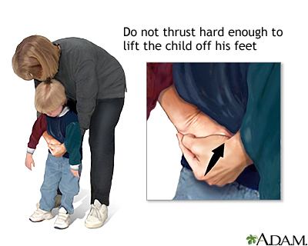
F.B inhalation

Slide 28
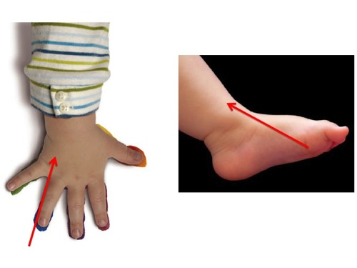
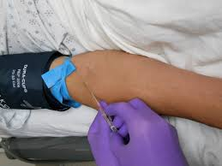
IV canulation

Slide 29
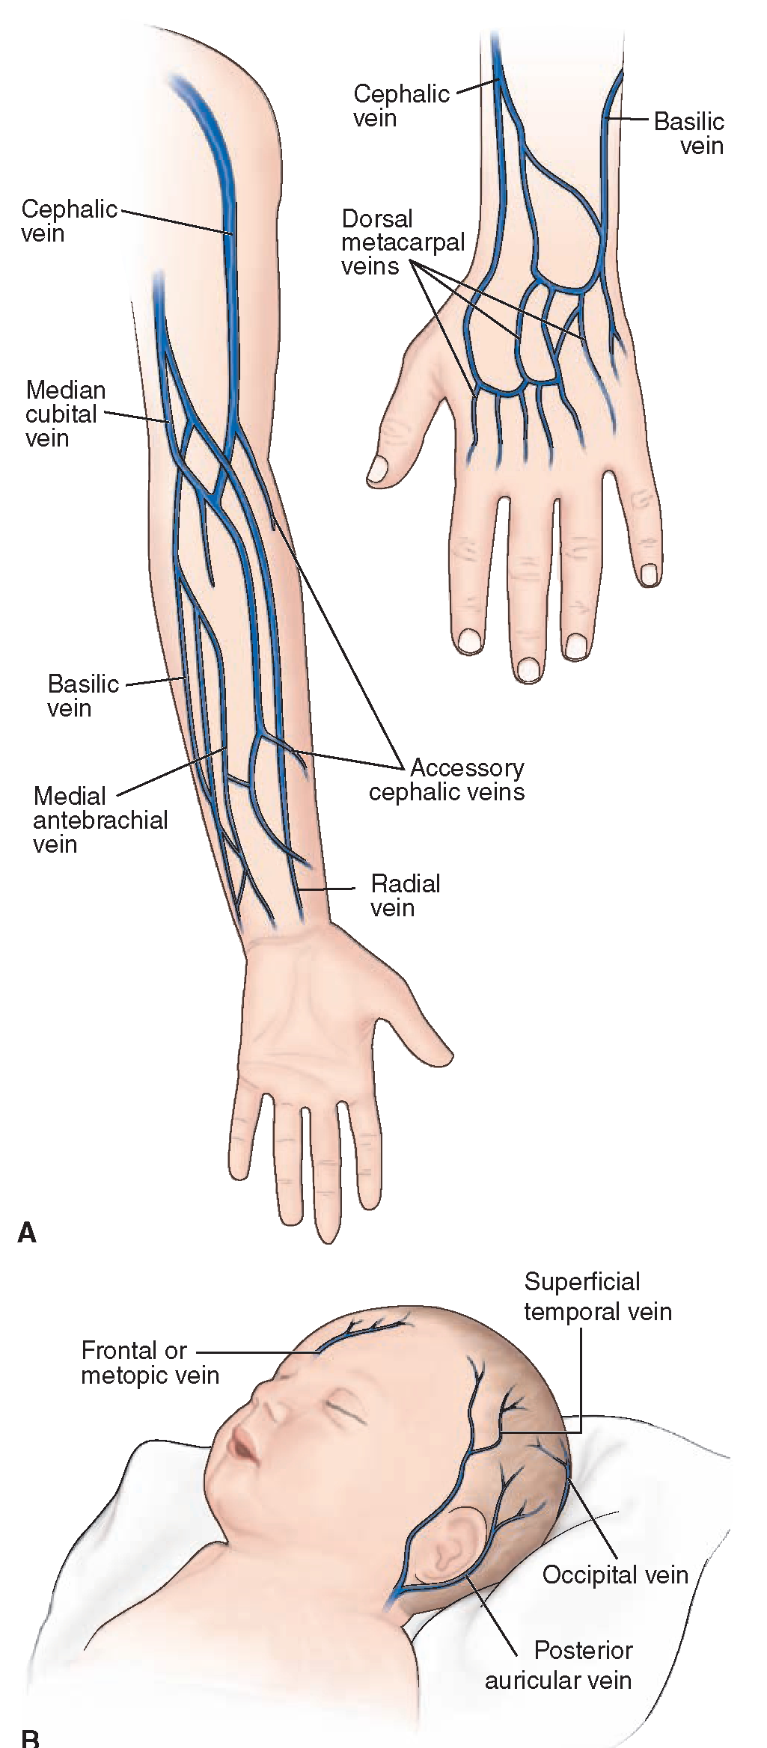

Slide 30
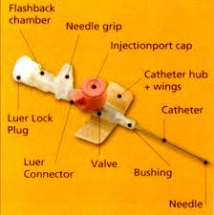
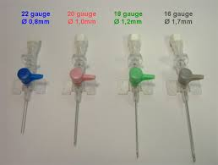

Slide 31
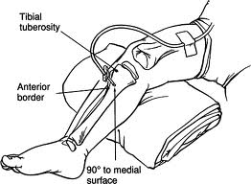
1- 18 gauge trochar with needle
2- Anterior surface 2-3 cm below tibial tuberosity
Intraosseus tibial infusion

Slide 32
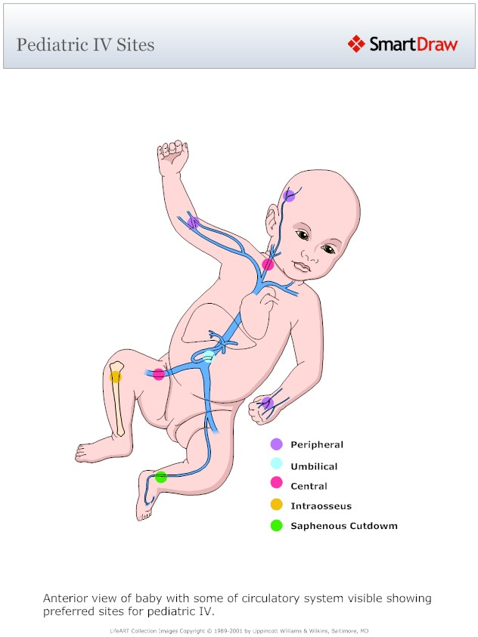

Slide 33


